Slide 1
Risk Determinations and Social Engineering
Edward Escobedo
Lewis University
CPsc-59700 Project Presentation

Slide 2
Introduction
Issue To Address
Social Engineering in Risk Assessments for the Navy
Why Is this important
Social Engineering Types
Navy Security Control Assessors
Risk Management Framework
Security Categorization
Security Controls
Variables to Consider
Recommendation Solution

Slide 3
ISSUE: Risk Determinations for the Navy
Navy Authorizing Authority (NAO) Tasking:
Assessors address Social Engineering
No general guidance exists
How much weight is should assessor consider

Slide 4
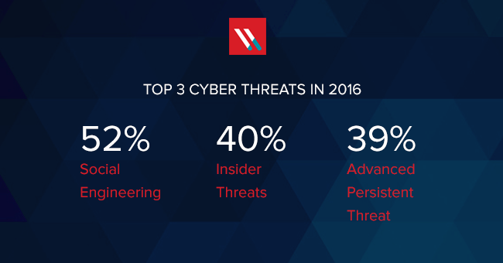
Social Engineering: Why is it Important
Most common attack
Gain information to penetrate networks and systems
No technical skill is necessary
Easiest attack due to human factor.

Slide 5
Social Engineering
Navy’s Biggest Issues
Phishing – 62%
Whaling – 22%
Vishing – 20%
Spim -25%

Slide 6
Navy Security Control Assessor
Risk Determinations for the Navy
440 Ships / 1850 Shore Stations
14 Assessors
Budget Cuts
4 Hours per system

Slide 7
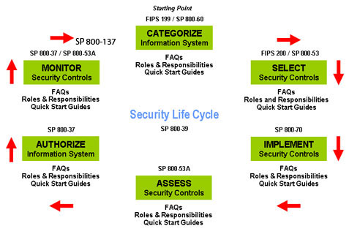
Navy Security Control Assessor
Risk Management Framework
Repository for all system accreditations
Program provide all Information
Certification and Accreditation plan
Architecture and data flow diagrams
Hardware/Software and Ports used
Risk Assessment Report and POA&M
Risk Determination
High, Medium, Low

Slide 8
Security Controls
18 Family of controls
Compliance
Scans needed to prove
Social Engineering can cover multiple controls
How to prove controls is complaint

Slide 9
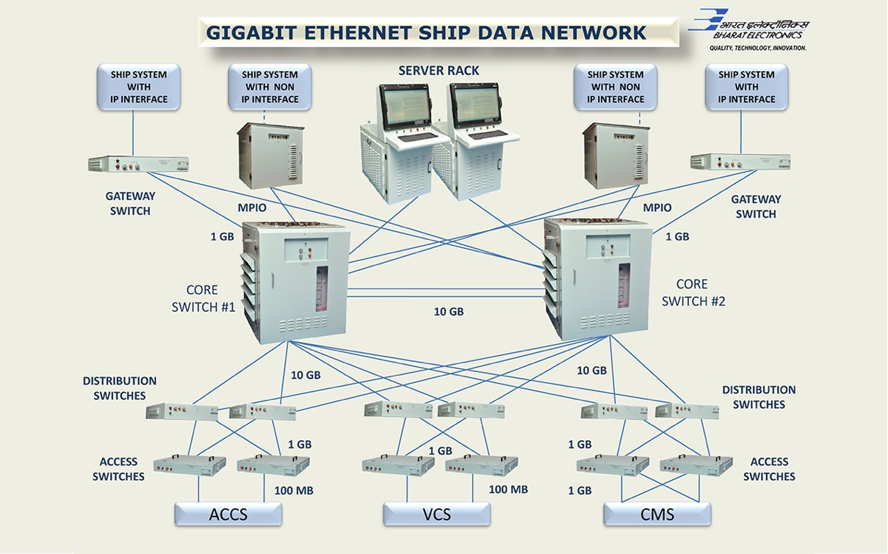
Variables for Considerations
Starting Point
Security Polices
Security Awareness
Quarterly Training is Required
Most neglected step
System Complexity
Number of Users
Privileged accounts to regular accounts

Slide 10
Solution/Recommended Checklist
Checklist will address the social engineering issues
Will not be a separate assessment
Risk Determination
Accompany original assessment
Based on Categorization
CIA Triad

Slide 11
Checklist
 | Social Engineering Risk Checklist
Risk Factor | Variables
System Characteristics | Understand purpose Number of General User/Privileged Users Is system public facing
Access Control | Is PKI used Dual Authentication Biometrics

Slide 12
Checklist
Security Polices | Written set of Social engineering policies Visitor Management Internet usage policy User ID and Password Policy Mobile Technology Use
Physical Security
Data | Hard and Soft Copy Materials
Applications | Black and Whitelisting
Awareness and Training | How often Security Training/Awareness conducted How does program track compliance
Incident Response | How does program track incidents Reporting and Incident Response Procedures

Slide 13
Conclusion
SCA tasked to address social engineering
Easy exploit due to human factor
Different types to address
Navy Assessors personnel and number of systems
Program provides all information
Creation of a standard checklist

Slide 14
Questions

